Slide 1
Week 08 CST2555 2023/24 Operating Systems and Computer Networks
Dr Ali Khoshkholghi
a.khoshkholghi@mdx.ac.uk
Lecturer in Computer Science

Slide 2
What we will learn today
Virtual Memory
Page Faults
Page Replacement
Frame Allocation
Thrashing

Slide 3
Virtual memory
We discussed various memory-management strategies used in computer systems. All these strategies have the same goal: to keep many processes in memory simultaneously to allow multiprogramming.
However, they tend to require that an entire process be in memory before it can execute.
Virtual memory is a technique that allows the execution of processes that are not completely in memory.
Virtual memory abstracts main memory into an extremely large, uniform array of storage, separating logical memory as viewed by the programmer from physical memory.
This technique frees programmers from the concerns of memory-storage limitations.

Slide 4
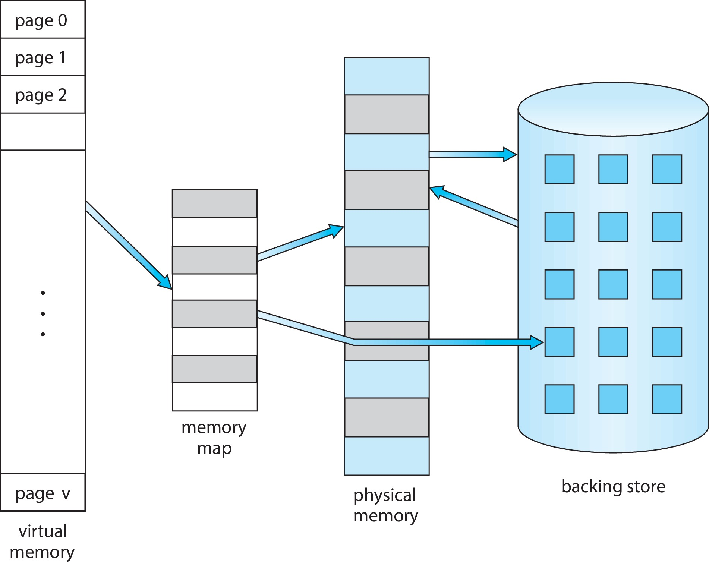
Virtual memory (Cont.)
Virtual memory – separation of user logical memory from physical memory
Only part of the program needs to be in memory for execution
Logical address space can therefore be much larger than physical address space
Allows address spaces (memory frames) to be shared by several processes
Allows for more efficient process creation (using shared frames)
More programs running concurrently

Slide 5
Virtual memory Benefits
A program would no longer be constrained by the amount of physical memory that is available. Users would be able to write programs for an extremely large virtual address space, simplifying the programming task. Then OS will manage the mapping task.
Because each program could take less physical memory, more programs could be run at the same time (multi-programming), with a corresponding increase in CPU utilization and throughput but with no increase in response time or turnaround time.
Less I/O would be needed to load or swap portions of programs into memory, so each program would run faster.

Slide 6
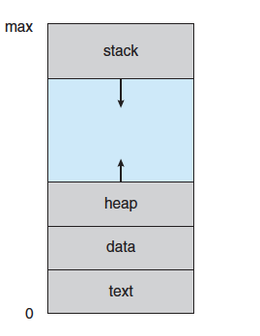
Virtual memory (Cont.)
Virtual address space – logical view of how process is stored in memory
Usually start at address 0, contiguous addresses until end of space
Meanwhile, physical memory organized in page frames
MMU must map logical to physical
Virtual memory can be implemented via:
Demand paging
Demand segmentation
Virtual address space of a process in memory.

Slide 7
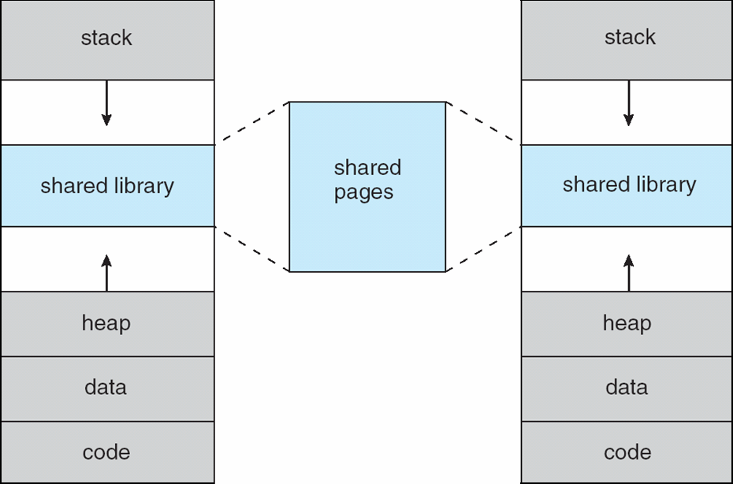
Shared Library Using Virtual Memory

Slide 8
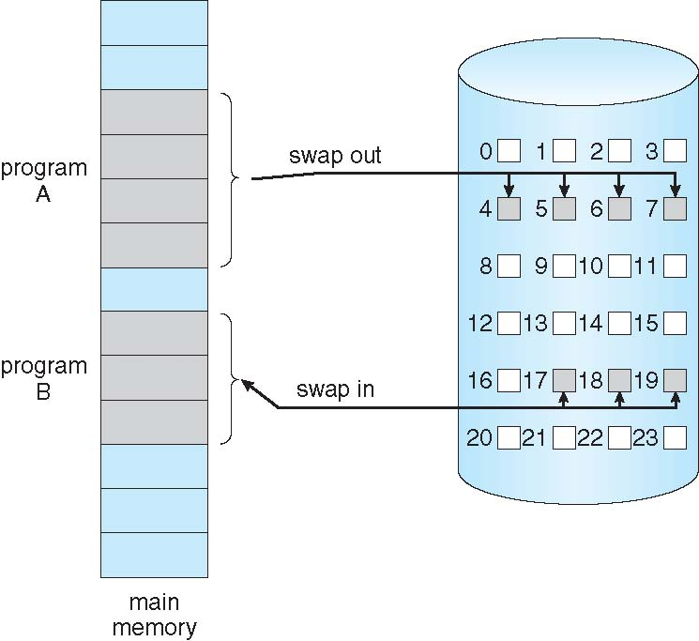
Demand Paging
Could bring entire process into memory at load time
Or bring a page into memory only when it is needed
Less I/O needed, no unnecessary I/O
Less memory needed
Faster response
More users
Similar to paging system with swapping (diagram on right)

Slide 9
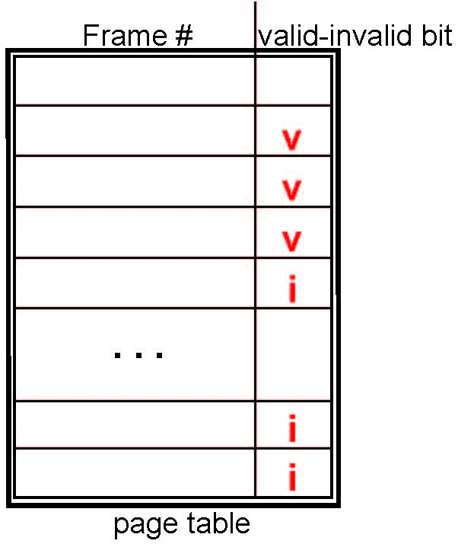
Valid-Invalid Bit
With each page table entry a valid–invalid bit is associated (v ⇒ in-memory – memory resident, i ⇒ not-in-memory)
Initially valid–invalid bit is set to i on all entries
Example of a page table snapshot:
During MMU address translation, if valid–invalid bit in page table entry is i ⇒ page fault

Slide 10
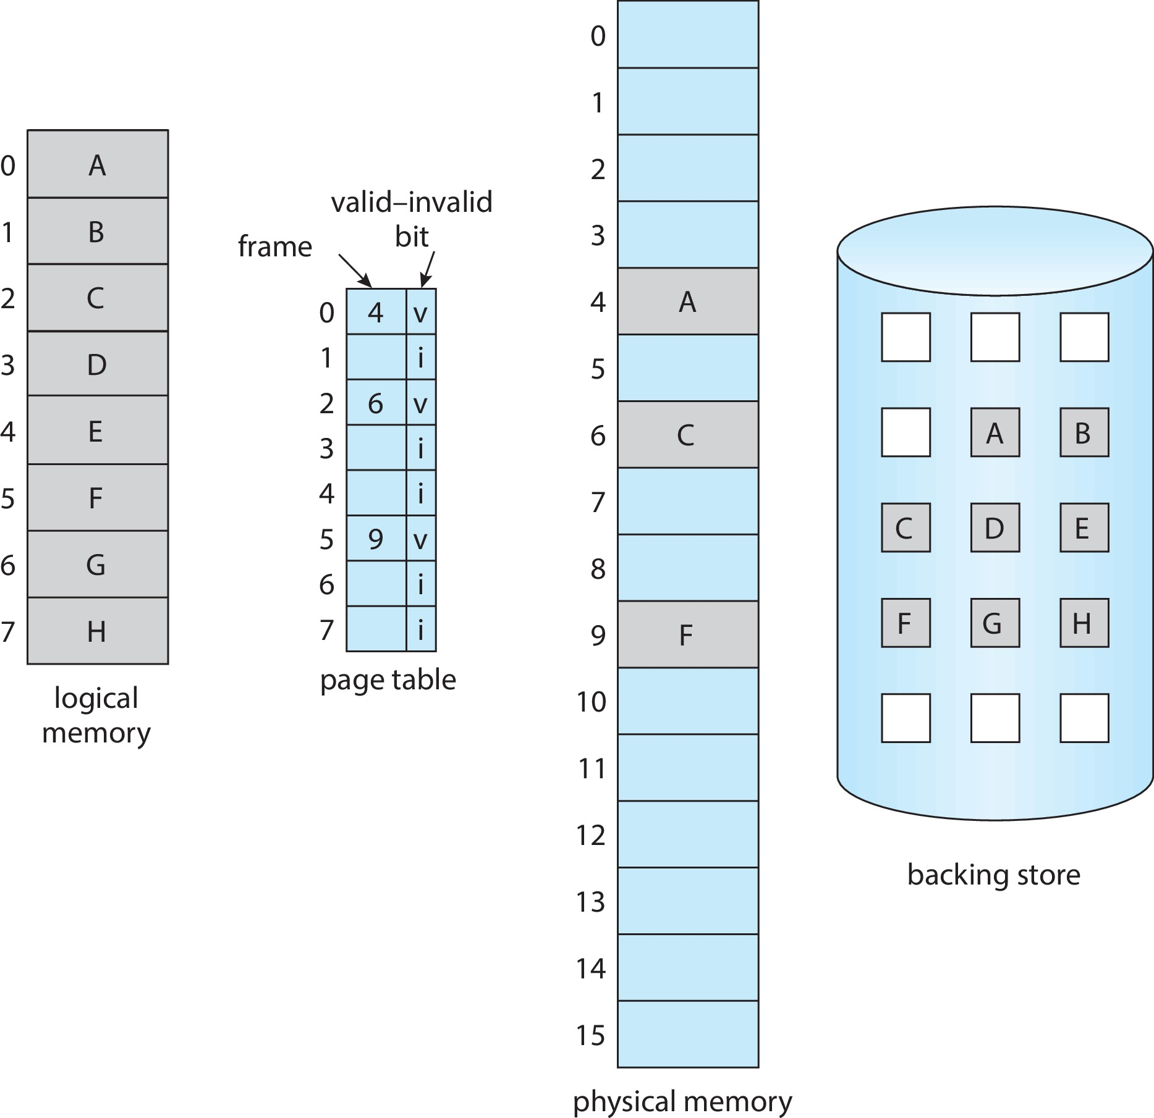
Page Table When Some Pages Are Not in Main Memory

Slide 11
Steps in Handling Page Fault
If there is a reference to a page, first reference to that page will trap to operating system
Page fault
Operating system looks at another table to decide:
Invalid reference ⇒ abort
Just not in memory
Find free frame
Swap page into frame via scheduled disk operation
Reset tables to indicate page now in memory Set validation bit = v
Restart the instruction that caused the page fault

Slide 12
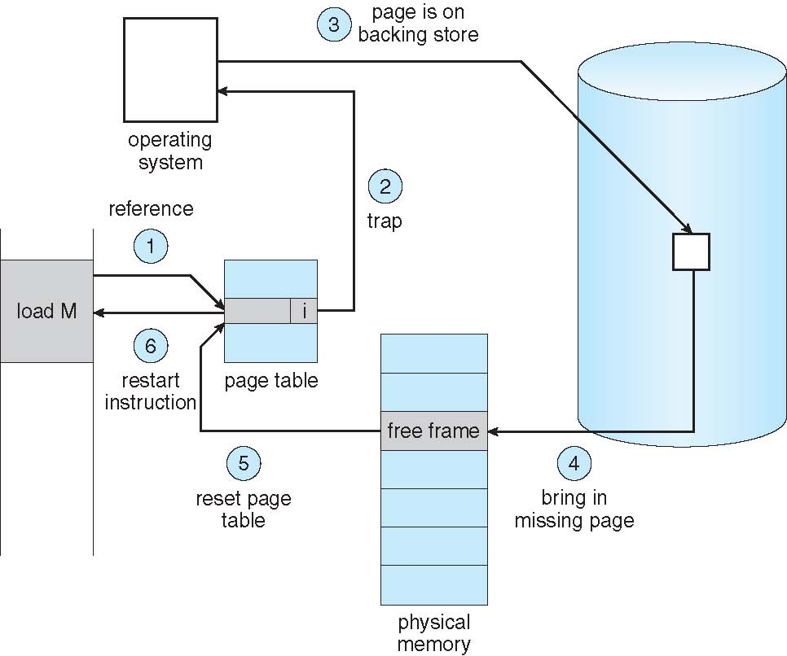
Steps in Handling a Page Fault (Cont.)

Slide 13
Aspects of Demand Paging
Extreme case – start process with no pages in memory
OS sets instruction pointer to first instruction of process, non-memory-resident -> page fault
And for every other process pages on first access
Pure demand paging
Actually, a given instruction could access multiple pages -> multiple page faults
Consider fetch and decode of instruction which adds 2 numbers from memory and stores result back to memory
Pain decreased because of locality of reference
Hardware support needed for demand paging
Page table with valid / invalid bit
Secondary memory (swap device with swap space)
Instruction restart

Slide 14
Free-Frame List
When a page fault occurs, the operating system must bring the desired page from secondary storage into main memory.
Most operating systems maintain a free-frame list -- a pool of free frames for satisfying such requests.
Operating system typically allocate free frames using a technique known as zero-fill-on-demand -- the content of the frames zeroed-out before being allocated.
When a system starts up, all available memory is placed on the free-frame list.

Slide 15
Demand paging performance
Trap to the OS
Save the user registers and process state
Determine that the interrupt was a page fault
Check the page reference was legal and find the page on disk
Issue a read from the disk into a free frame
Wait in a queue for this device until the read request is serviced
Wait for the device seek a free frame
Begin the transfer of the page to a free frame (I/O)
Reallocate CPU to another program
Receive an interrupt when disk I/O completes
Save the registers and process state for the other program
Determine that the interrupt was from the disk
Correct page table and other tables to show page is now in memory
Wait for the CPU to be allocated to this process again
Restore the user registers, process
state, and new page table, and then
resume the interrupted instruction.

Slide 16
Performance of Demand Paging
Three major activities
Service the interrupt – careful coding means just several hundred instructions needed (small amount of time)
Read the page – lots of time
Restart the process – again just a small amount of time
Page Fault Rate 0 ≤ p ≤ 1
if p = 0 no page faults
if p = 1, every reference is a fault (worse case)
Effective Access Time (EAT)
EAT = (1 – p) x memory access
+ p (page fault overhead
+ swap page out
+ swap page in )

Slide 17
Demand Paging Example
Memory access time = 200 nanoseconds
Average page-fault service time = 8 milliseconds
EAT = (1 – p) x 200 + p (8 milliseconds)
= (1 – p x 200 + p x 8,000,000
= 200 + p x 7,999,800
If one access out of 1,000 causes a page fault, then
EAT = 8.2 microseconds.
This is a slowdown by a factor of 40!!
If want performance degradation < 10 percent
220 > 200 + 7,999,800 x p 20 > 7,999,800 x p
p < .0000025
one page fault in every 400,000 memory accesses

Slide 18
Demand Paging Optimizations
Swap space I/O faster than file system I/O even if on the same device
Swap allocated in larger chunks, less management needed than file system
Copy entire process image to swap space at process load time
Then page in and out of swap space
Used in older BSD Unix
Demand page in from program binary on disk, but discard rather than paging out when freeing frame
Used in Solaris and current BSD
Still need to write to swap space
Pages not associated with a file (like stack and heap) – anonymous memory
Pages modified in memory but not yet written back to the file system
Mobile systems
Typically don’t support swapping
Instead, demand page from file system and reclaim read-only pages (such as code)

Slide 19
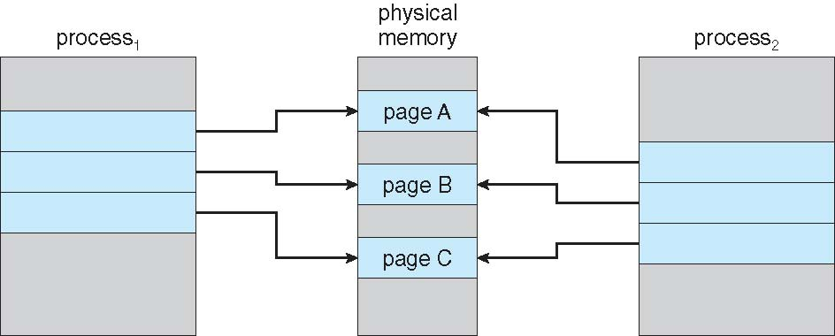
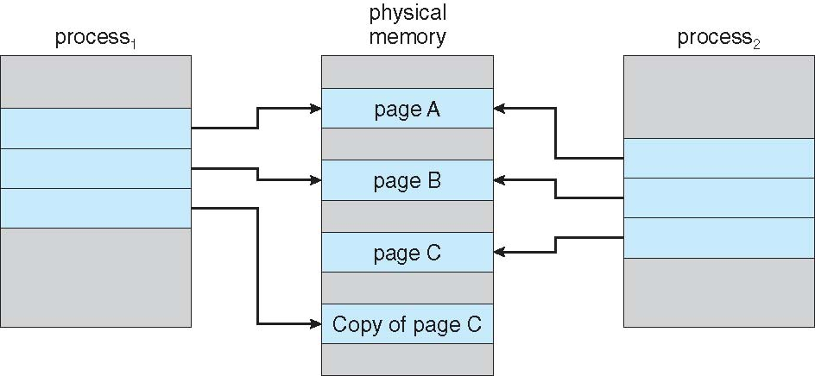
Copy-on-Write
Copy-on-Write (COW) allows both parent and child processes to initially share the same pages in memory
If either process modifies a shared page, only then is the page copied
COW allows more efficient process creation as only modified pages are copied
In general, free pages are allocated from a pool of zero-fill-on-demand pages
Pool should always have free frames for fast demand page execution
Don’t have to free a frame as well as other processing on page fault
Before Process 1 Modifies Page C
After Process 1 Modifies Page C

Slide 20
What Happens if There is no Free Frame?
Memory can be used up by process pages
Also, in demand from the kernel and I/O buffers.
How much to allocate to each?
Some systems allocate a fixed percentage of memory for I/O buffers,
whereas others allow both processes and the I/O subsystem to compete for all system memory
Page replacement – find some page in memory, but not really in use, page it out
Algorithm – terminate? swap out? replace the page?
Performance – want an algorithm which will result in minimum number of page faults
Same page may be brought into memory several times

Slide 21
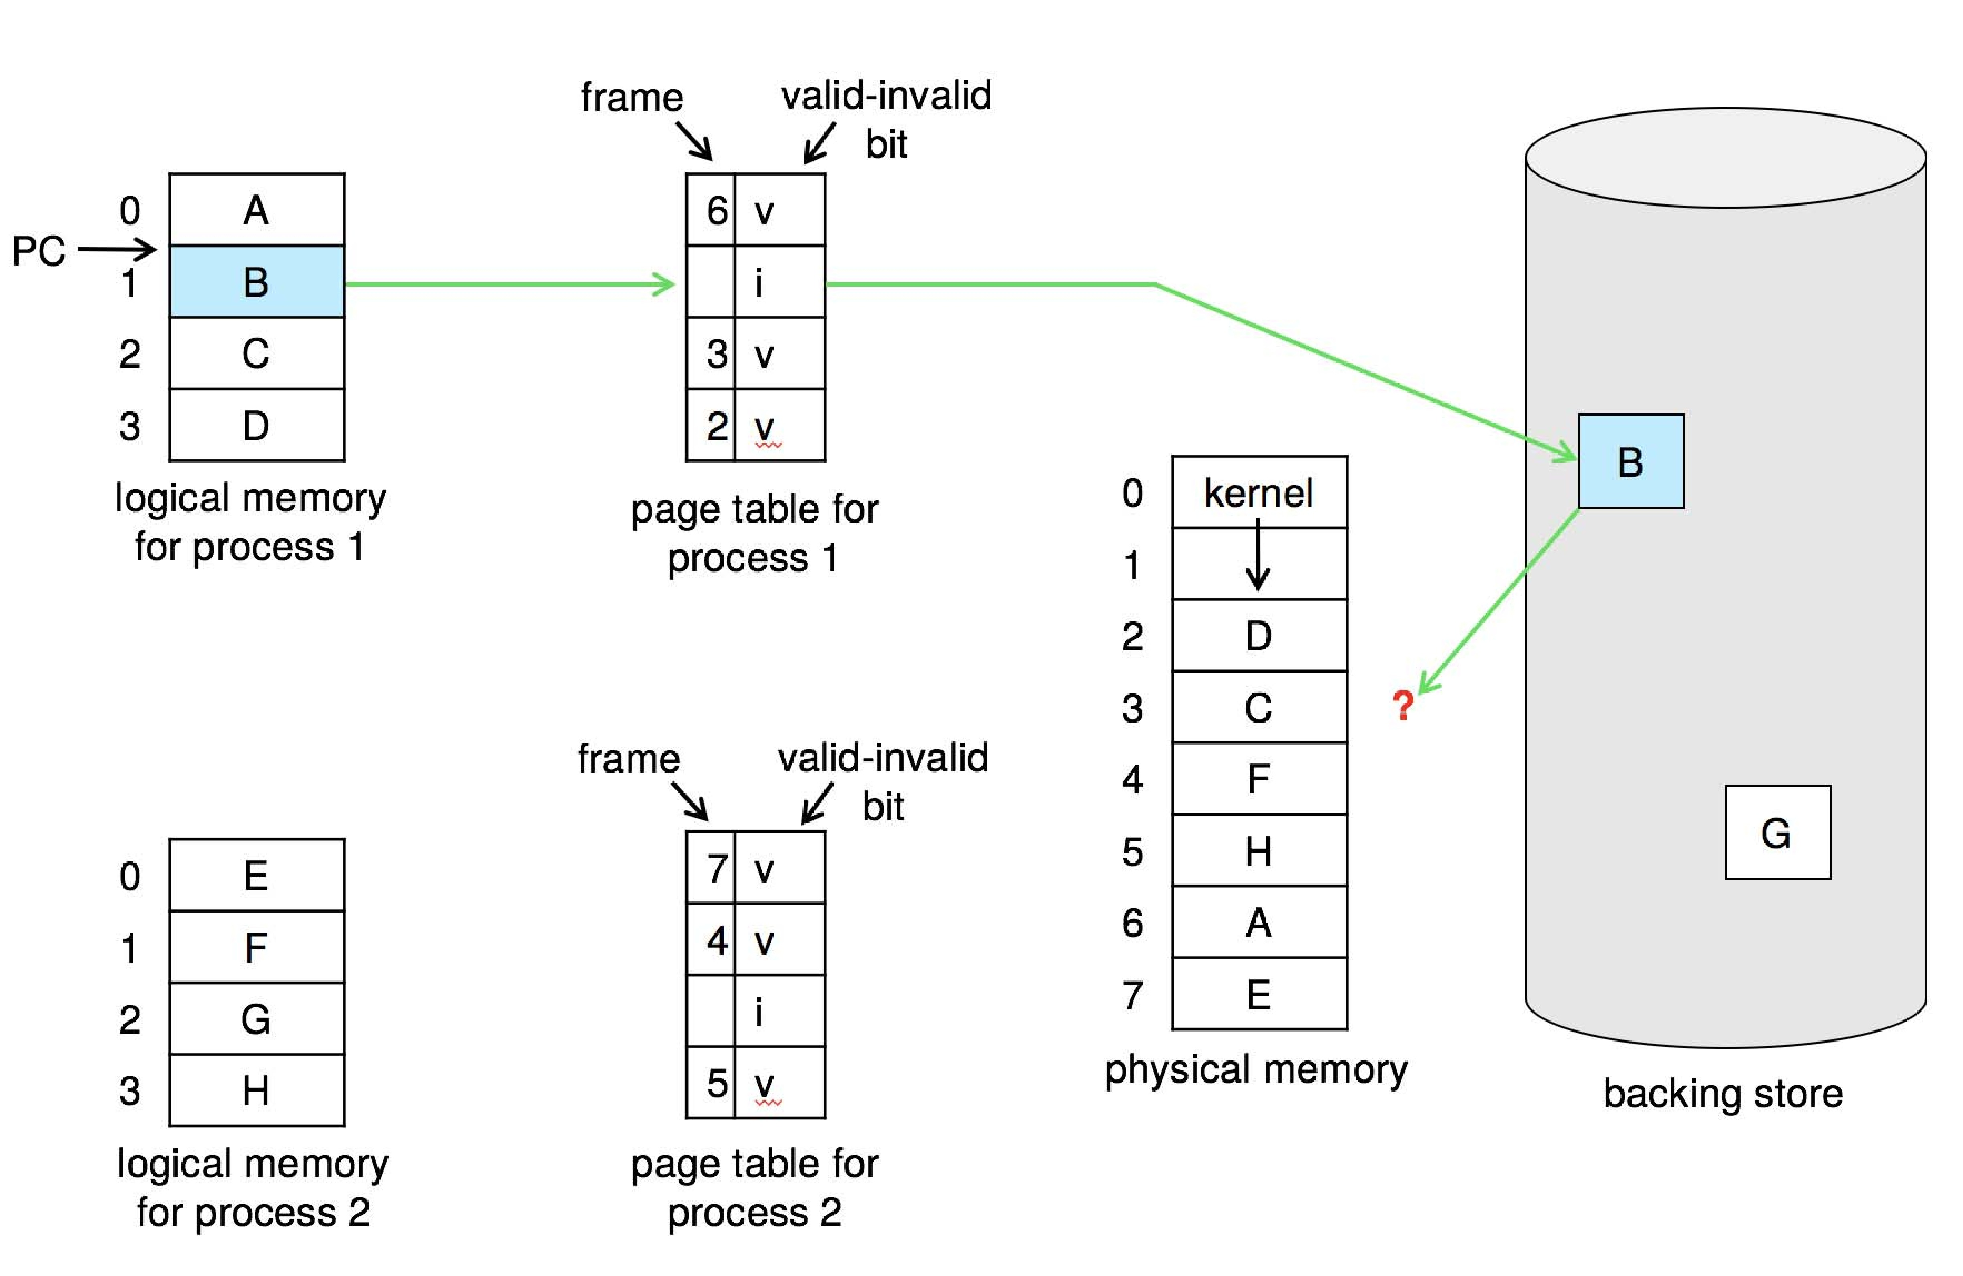
Page Replacement
Modifying page-fault service routine (using swapping) to include page replacement
Use modify (dirty) bit to reduce overhead of page transfers – only modified pages are written to disk
Page replacement completes separation between logical memory and physical memory – large virtual memory can be provided on a smaller physical memory.

Slide 22
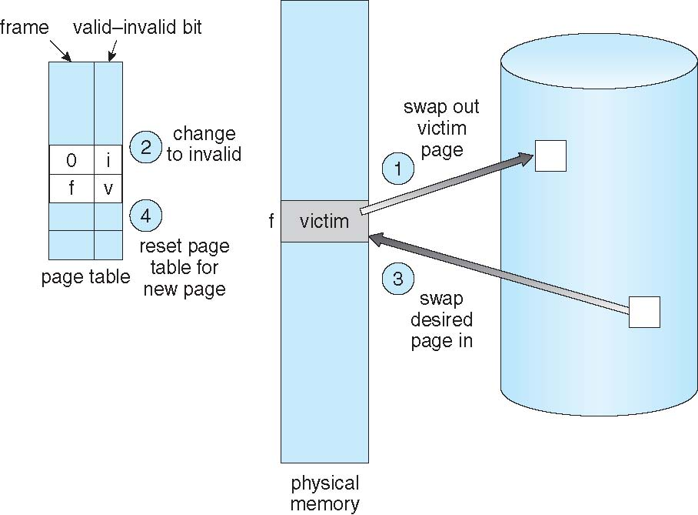
Basic Page Replacement
Find the location of the desired page on disk
Find a free frame: - If there is a free frame, use it - If there is no free frame, use a page replacement algorithm to select a victim frame - Write victim frame to disk if dirty
Bring the desired page into the (newly) free frame; update the page and frame tables
Continue the process by restarting the instruction that caused the trap
Note now potentially 2 page transfers for page fault – increasing EAT
Solution: Dirty bit

Slide 23
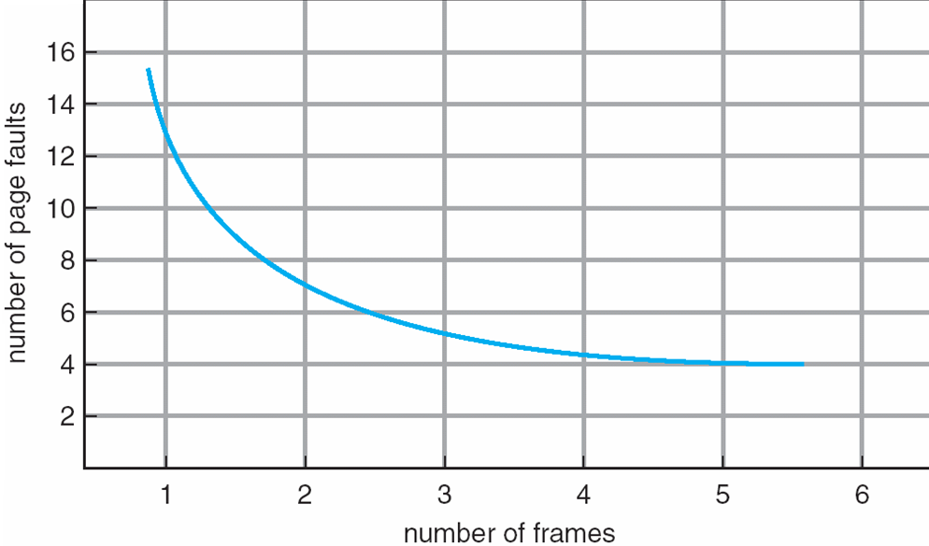
Page and Frame Replacement Algorithms
Frame-allocation algorithm determines
How many frames to give each process
Which frames to replace
Page-replacement algorithm
Want lowest page-fault rate on both first access and re-access
Graph of Page Faults Versus the Number of Frames

Slide 24
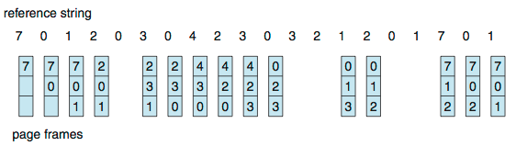
First-In-First-Out (FIFO) Algorithm
Page reference string: 7,0,1,2,0,3,0,4,2,3,0,3,2,1,2,0,1,7,0,1
3 frames (3 pages can be in memory at a time per process)
Can vary by reference string: consider 1,2,3,4,1,2,5,1,2,3,4,5
Adding more frames can cause more page faults!
Belady’s Anomaly
How to track ages of pages?
Just use a FIFO queue
15 page faults

Slide 25
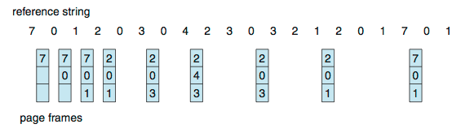
Optimal Algorithm
Replace page that will not be used for longest period of time
9 page faults is optimal for the example
How do you know this?
Can’t read the future
Used for measuring how well your algorithm performs

Slide 26
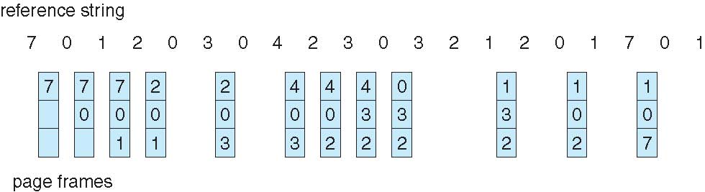
Least Recently Used (LRU) Algorithm
Use past knowledge rather than future
Replace page that has not been used in the most amount of time
Associate time of last use with each page
12 faults – better than FIFO but worse than OPT
Generally good algorithm and frequently used
But how to implement?

Slide 27
LRU Algorithm (Cont.)
Counter implementation
Every page entry has a counter; every time page is referenced through this entry, copy the clock into the counter
When a page needs to be changed, look at the counters to find smallest value
Search through table needed
Stack implementation
Keep a stack of page numbers in a double link form:
Page referenced:
move it to the top
LRU and OPT are cases of stack algorithms that don’t have Belady’s Anomaly
Use Of A Stack to Record Most Recent Page References

Slide 28
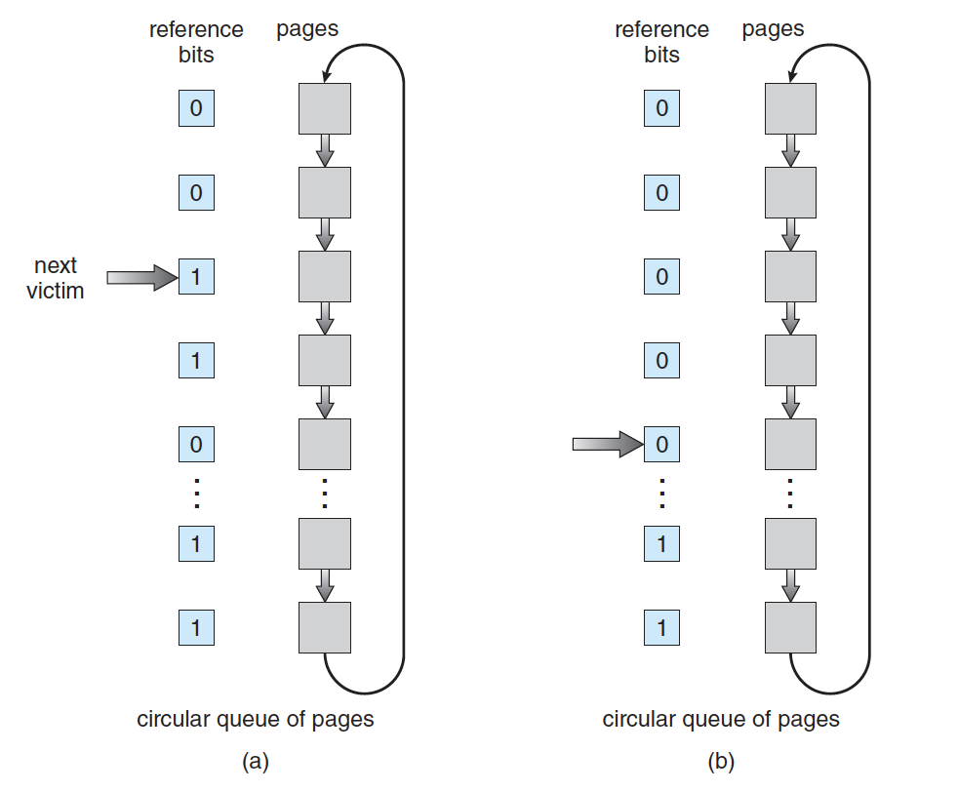
LRU Approximation Algorithms
LRU is slow
Using reference bit
With each page associate a bit, initially = 0
When page is referenced bit set to 1
Replace any with reference bit = 0 (if one exists)
Second-chance algorithm (clock algorithm)
Generally FIFO, plus reference bit
If page to be replaced has
Reference bit = 0 -> replace it
reference bit = 1 then:
set reference bit 0, leave page in memory
replace next page, subject to same rules

Slide 29
Enhanced Second-Chance Algorithm
Improve algorithm by using reference bit and modify bit (if available)
Take ordered pair (reference, modify):
Referenced? | Dirty? | Comment
no | no | best type of page to evict
no | yes | next best (needs writeback)
yes | no | probably code in use
yes | yes | bad choice of victim

Slide 30
Counting Algorithms
Keep a counter of the number of references that have been made to each page
Not common
Lease Frequently Used (LFU) Algorithm:
Replaces page with smallest count
Most Frequently Used (MFU) Algorithm:
Based on the argument that the page with the smallest count was probably just brought in and has yet to be used

Slide 31
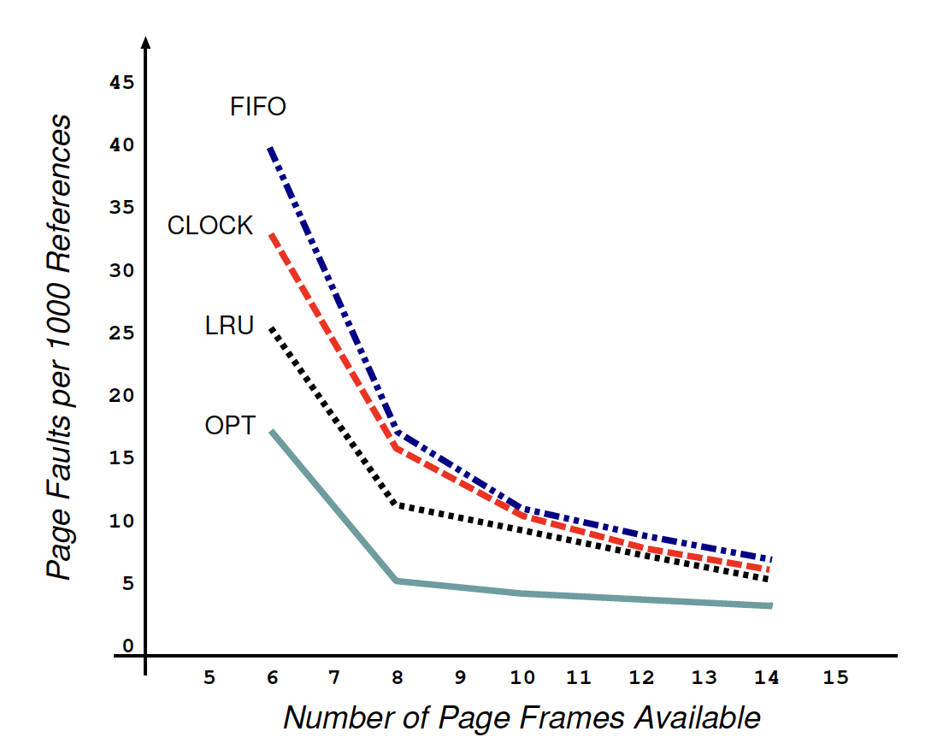
Page replacement performance comparison

Slide 32
Allocation of Frames
Need an allocation policy to determine how to distribute frames
Each process needs minimum number of frames
Example: IBM 370 – 6 pages to handle MOVE instruction:
instruction is 6 bytes, might span 2 pages
2 pages to handle from
2 pages to handle to
Maximum of course is total frames in the system
Two major allocation schemes
fixed allocation
priority allocation

Slide 33
Frame Allocation
Equal allocation – For example, if there are 100 frames (after allocating frames for the OS) and 5 processes, give each process 20 frames
Proportional allocation – Allocate according to the size of process
Dynamic as degree of multiprogramming, process sizes change

Slide 34
Global vs. Local Frame Allocation
Global replacement – process selects a replacement frame from the set of all frames; one process can take a frame from another
But then process execution time can vary greatly
But greater throughput so more common
Local replacement – each process selects from only its own set of allocated frames
More consistent per-process performance
But possibly underutilized memory

Slide 35
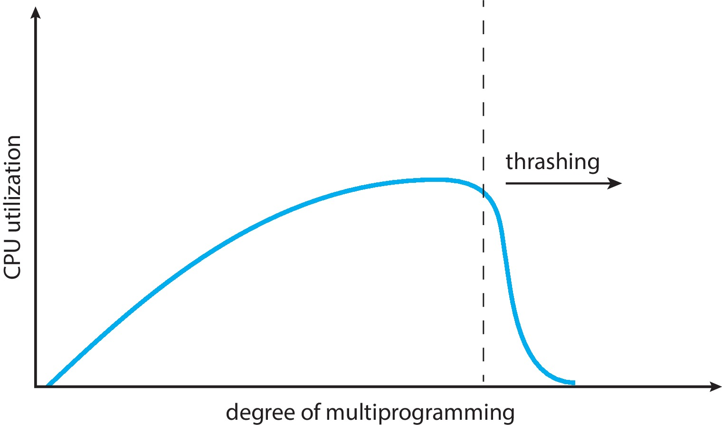
Thrashing
If a process does not have “enough” pages, the page-fault rate is very high
Page fault to get page
Replace existing frame
But quickly need replaced frame back
This leads to:
Low CPU utilization
Operating system thinking that it needs to increase the degree of multiprogramming
Another process added to the system
Thrashing. A process is busy swapping pages in and out
Solution?
Working-set model

Slide 36
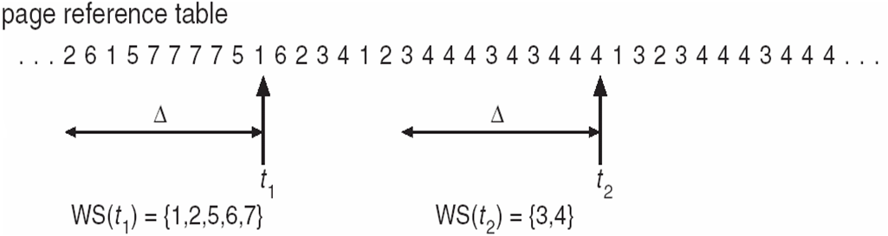
Working-Set Model
Δ ≡ working-set window ≡ a fixed number of page references Example: 10,000 instructions
WSS_{i} (working set of Process P_{i}) = total number of pages referenced in the most recent Δ
D = Σ WSS_{i} ≡ total demand frames
if D > m ⇒ Thrashing
Policy if D > m, then suspend or swap out one of the processes

Slide 37
End of Week 8

